Slide 1

Does AR have a place in the future of Public Art?
2660428s
Notes:
Hello, welcome to my presentation about my level 4 individual project. My project concerned using Augmented Reality to display art in public spaces. Namely, whether this is something people would want to use, and how it changes a users perception of the space.

Slide 2
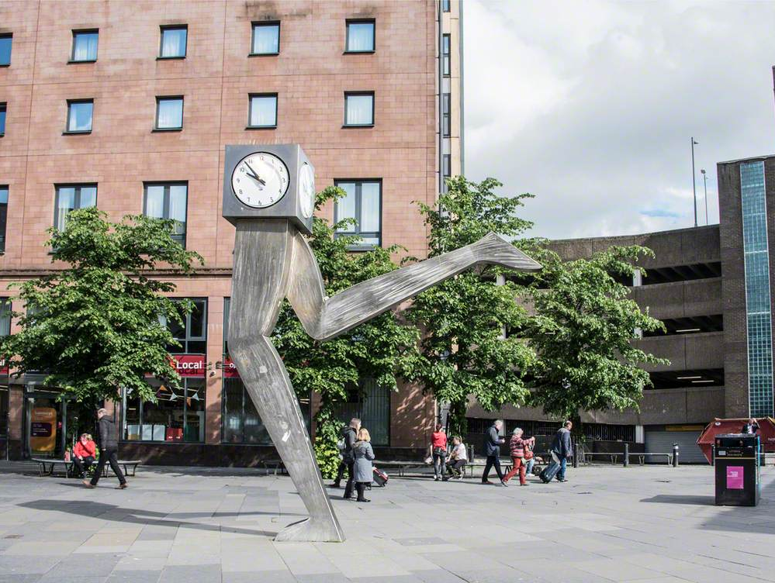
Motivation
Public Art is commonplace in modern society, but it is expensive to build
AR is becoming more commonplace in our society
With both of these together, Can we use AR as an alternative form of experiencing public art?
Notes:
Firstly, what was the motivation of the project? Well, public art is probably a bigger part of people's every lives than most realise. Most people pass some form of public art everyday, and whether they realise it consciously or not, it definitely affects their perception of the space. So, public art enriches peoples daily experience. However, building it often takes a lot of planning and time, and you have to make sure it's not too disruptive. Well, what if there was a way to display this public art in a space without this lengthy process. With the increasing ubiquity of Augmented Reality in our lives, with games such as Pokemon Go, or even something as innocuous as face filters, people are no strangers to seeing a digital layer over reality. Now what if we could use this to display public art.

Slide 3
Research Questions
RQ 1: Would people want to see public art in AR daily?
RQ 2: What kind of art works best in what types of public spaces?
RQ 3: Does AR art change the perception of a public space? If so, how?
Notes:
So, what were we looking for in this experiment. Firstly, we wanted to determine whether this was something that people would actually be interested in. Secondly, we wanted to find what kind of locations and which types of art worked for this type of experience, so that we can inform design choices if this idea comes to fruition. Lastly, we wanted to gather data on how this kind of experience changed someone's perception of the public space, was it positive? negative? Negligible?

Slide 4
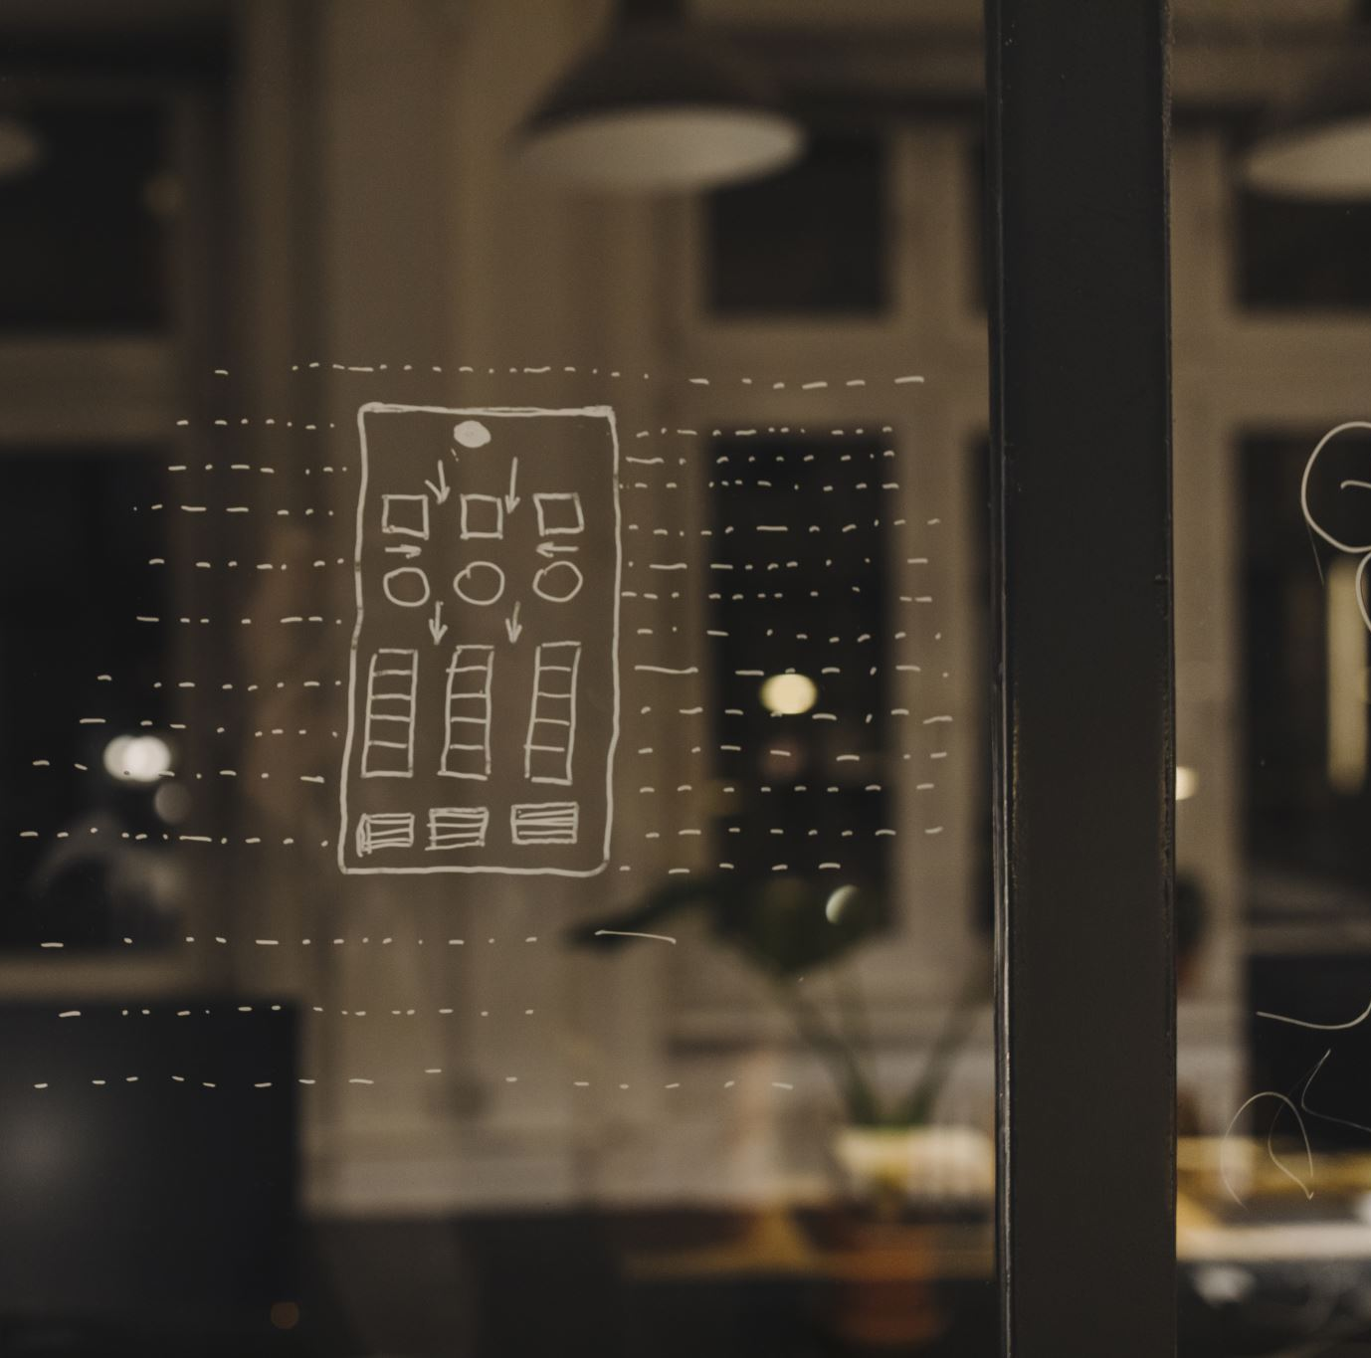
Design
Users place the prefabricated model into the real world.
Users will then be able to walk around the space.
There are different prefabricated elements for each condition of the experiment and the user can select each one from a menu
Notes:
So, how did we design this prototype. We built a simple experience which allowed the users to place prefabricated elements in predetermined locations, and then walk around them to experience the space with the new augmentations. There are different conditions, and the users will be able to swap between the prefabs for each conditions with a menu.

Slide 5
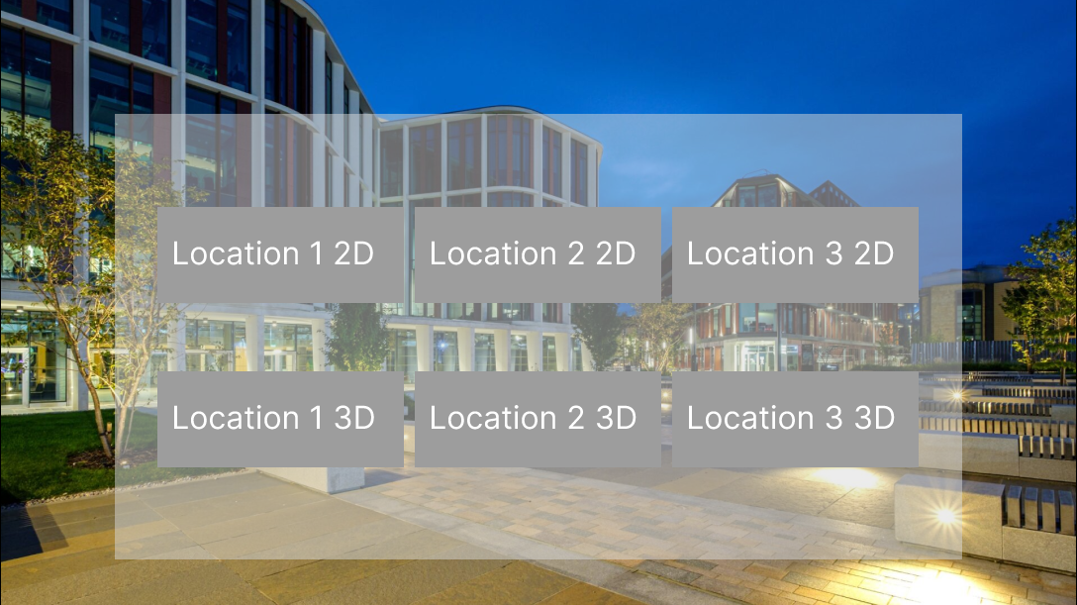
UI Design
Notes:
This is the simple swapping menu, allowing you to change between each of the conditions which are prebuilt for each location.

Slide 6
Experiment Design
Each Participant completes 3 art conditions: No art, 2D art, 3D art, at three different locations: University Avenue, East Quadrangle, ARC Courtyard
The users did two tasks at each location to get the feel for it. Walking through it like they were commuting, and walking around to enjoy the art.
They then filled in a survey for each condition, as well as a demographic and closing survey, and an interview.
Notes:
For the experiment design, we opted to have nine conditions, three for location and three for types of art. The three locations each represent different affordances and are, The ARC Courtyard, which represents a large open grey space, The East Quadrangle, which represents a smaller open space which also features greenery, finally, the last location is the top of University Avenue, this represents a smaller space, a road. We wanted to explore these locations because we identified these types of locations as some of the most common types of public spaces. For the types of art, we had three conditions, a base No Art condition, a condition with 2D art, and a condition with 3D art. We felt these represented the main categories of public art. For each condition the user walked around the location in two ways, firstly they walked through it as if they were commuting, secondly they walked through it specifically to look at the art. After each condition the participant filled in a survey. There was also a demographic and closing survey, alongside an interview.

Slide 7
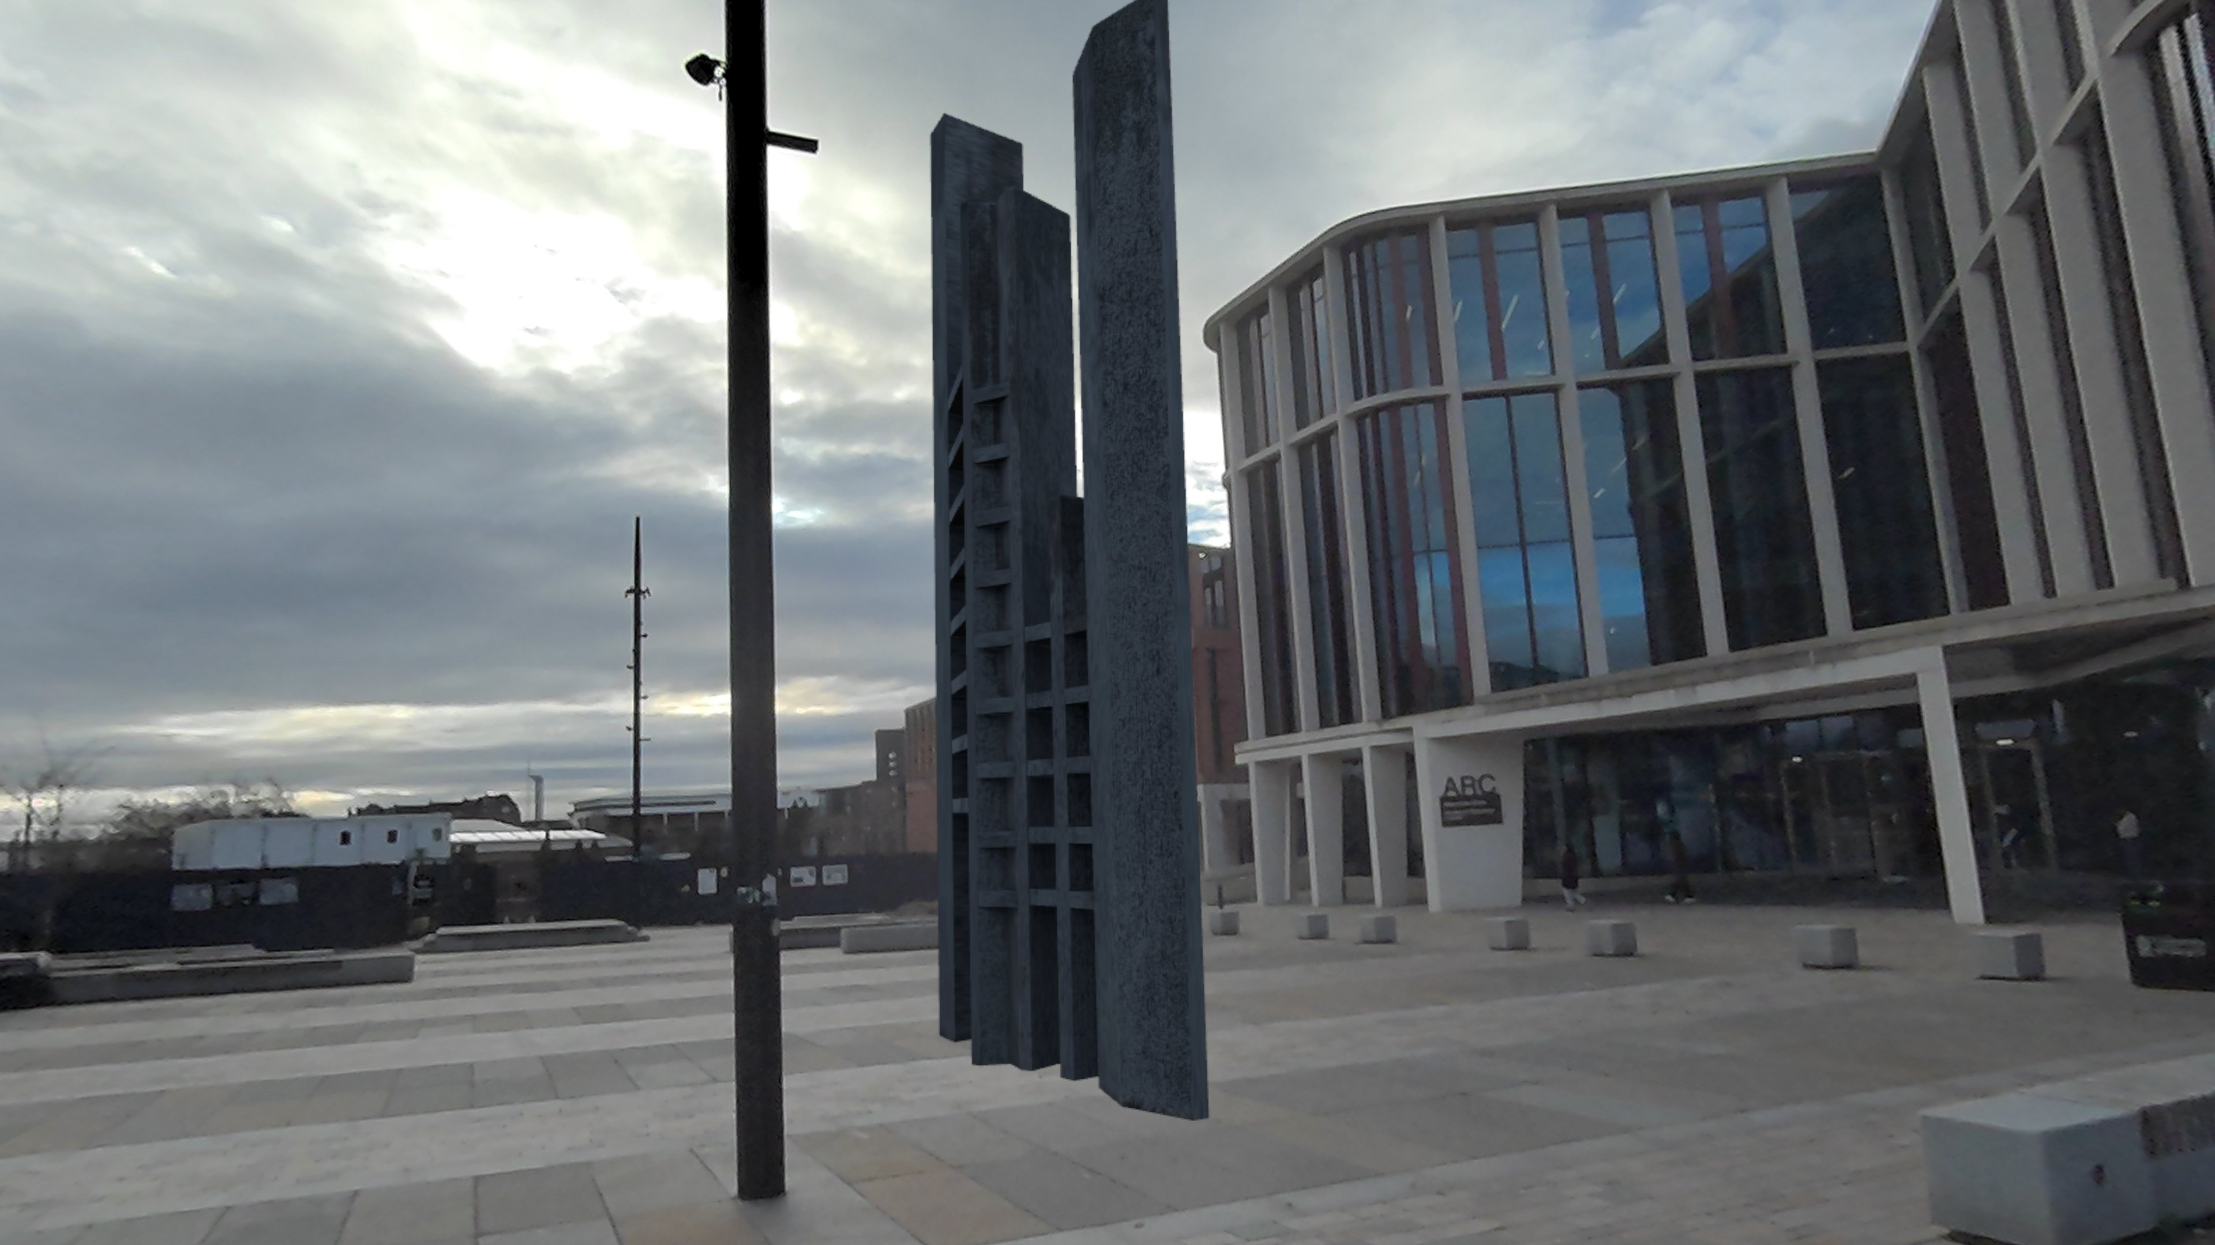
Demonstration
Notes:
Now I will show you a demonstration of the prototype in the different locations. I should preface the video by noting that due to limitations with the technology, I had to turn on the spatial features to record the video, this occasionally causes a blue mesh to appear, this was not present for the participants of the experiment.

Slide 8
Due to size issues, the video demonstration is hosted here: https://gla-my.sharepoint.com/:v:/g/personal/2660428s_student_gla_ac_uk/EV4anfVvT89FghjDrHAUQXABmLiOfOpwKLafdVUlPx8VQw?e=fWDhux&nav=eyJyZWZlcnJhbEluZm8iOnsicmVmZXJyYWxBcHAiOiJTdHJlYW1XZWJBcHAiLCJyZWZlcnJhbFZpZXciOiJTaGFyZURpYWxvZy1MaW5rIiwicmVmZXJyYWxBcHBQbGF0Zm9ybSI6IldlYiIsInJlZmVycmFsTW9kZSI6InZpZXcifX0%3D

Slide 9
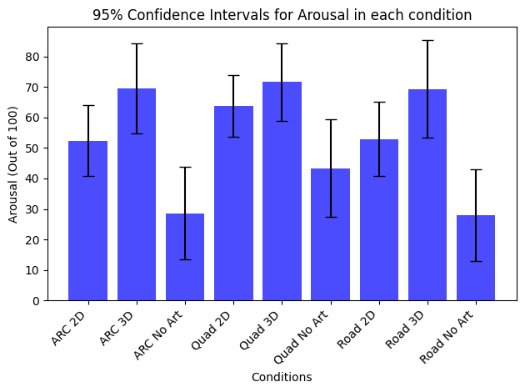
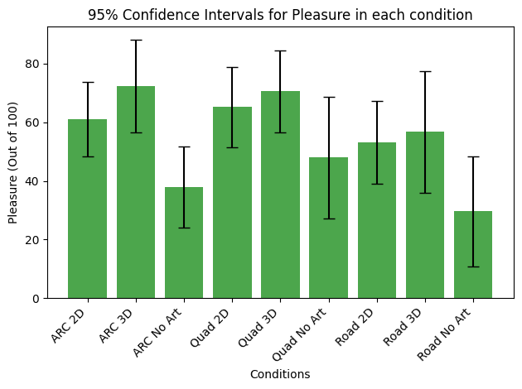
Statistical Significance for Affective Slider
Notes:
Following the experiment we did an analysis of the data. Firstly, we did a 95% confidence interval plot for data gathered from an affective slider. An affective slider is a standard survey which is used to gather data about how arousing or stimulating and how pleasurable or enjoyable a location is. A 95% confidence interval plot was used to show statistical significance. We can see from both plots that there is a statistical significance between the no art conditions and the other conditions, this is indicated by the error bars not overlapping, this indicates that the art improved the experience in every location. However, there is not a statistical significance between the different locations or art conditions, meaning that the preference shown in the averages could be different with a different sample of the population.

Slide 10
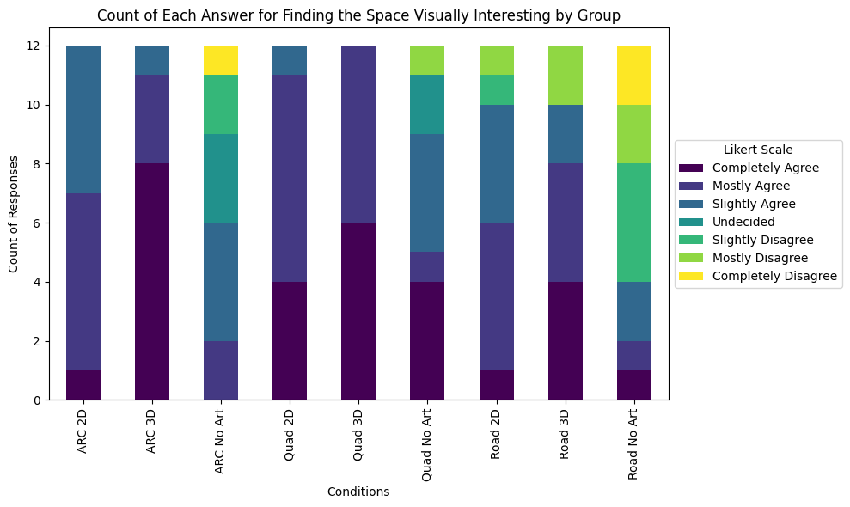
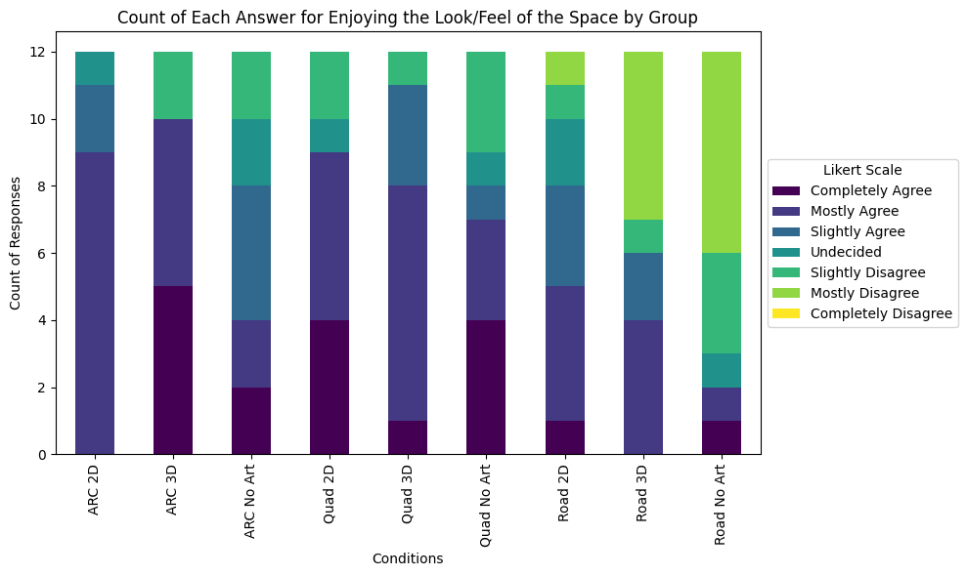
Likert scale questions – Look/Feel of the space
Notes:
Next, we made some stacked bar plots for each Likert scale question, the following are some of the most indicative of them. The graph on the left represents how visually interesting participants found it. The graph on the left represents how much participants enjoyed the look/feel of the space. Both of these graphs indicate that no art conditions were less enjoyable and interesting within their locations. It also further shows that the road is viewed as less interesting and visually enjoyable than the other locations.

Slide 11
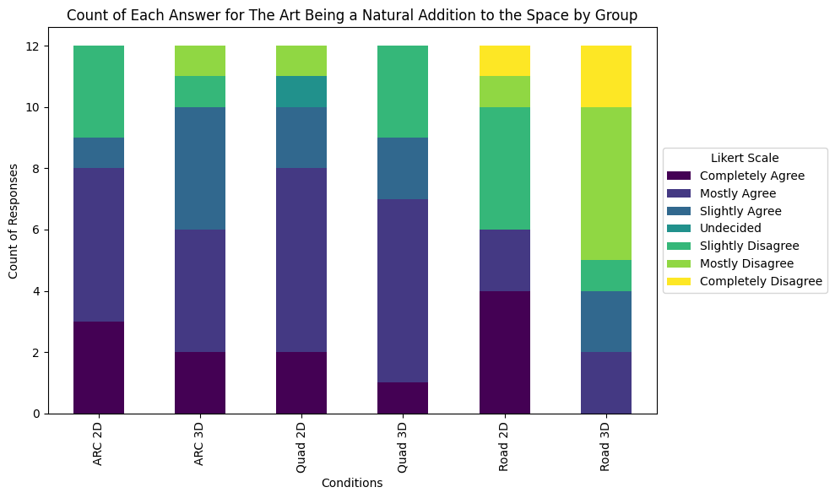
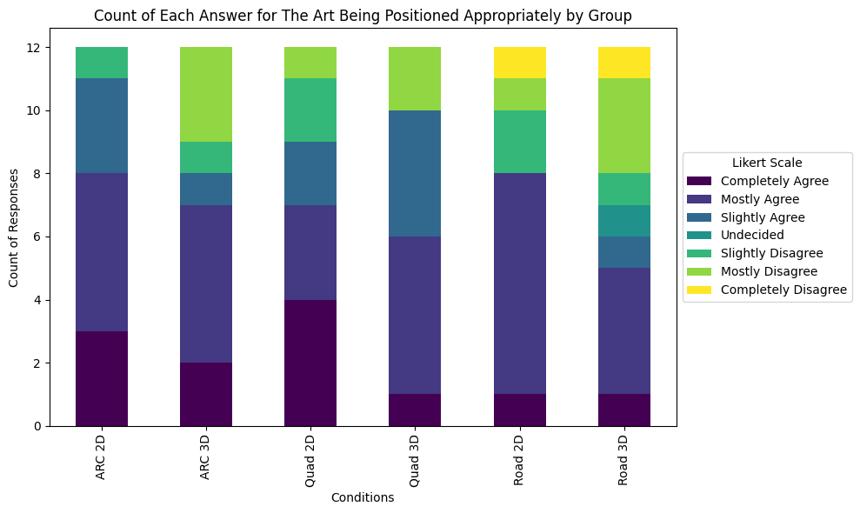
Likert Scale Questions – Art positioning
Notes:
The next Likert scale graphs represent how the art themselves fit into the spaces. The left graph represents the participants opinions on whether the art works as a natural addition to the space. The right graph represents the participants opinions on whether the art is positioned appropriately. We see a trend is these as well, generally people didn't the road for being a natural addition or being positioned appropriately. This could mean that it would work if positioned appropriately or it could mean it doesn't work for this location.

Slide 12
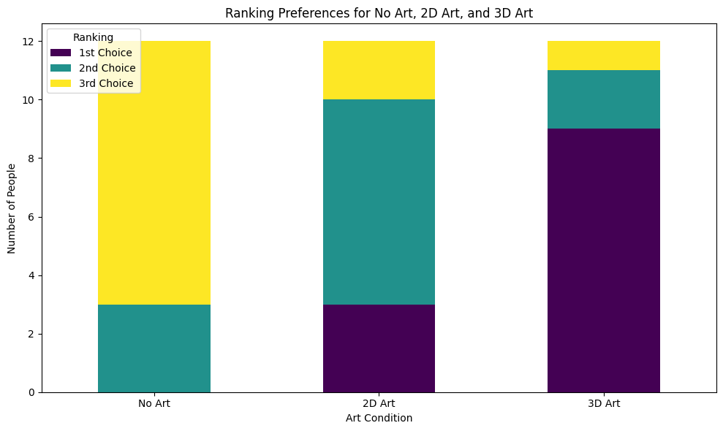
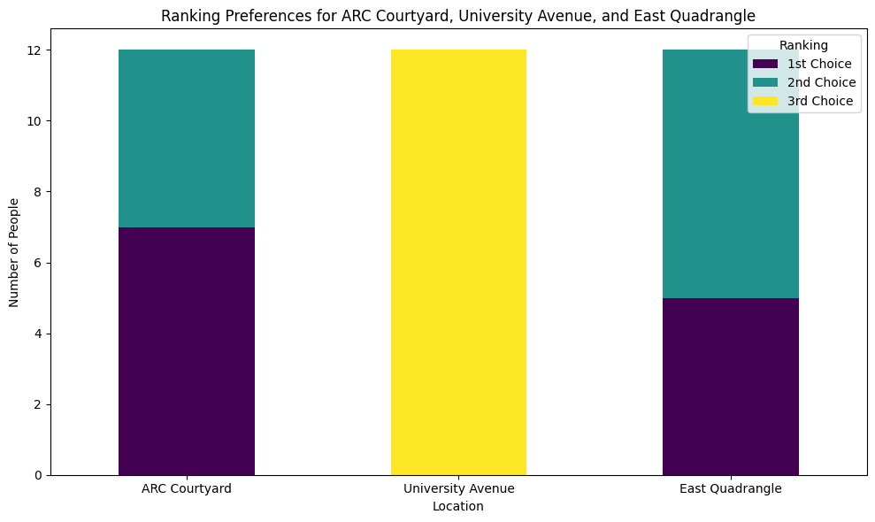
Ranking by Condition
Notes:
Next, we analysed the data from the closing survey, where we asked the participants to rank the different conditions. Firstly, we asked them to rank the locations, and rank the type of art. From this data we made more stacked box plots. Looking at the graph on the left, we can see that the no art condition is seen as the least liked, with the 2D and then 3D beating it. 3D is seen as the best, this corroborates the other data provided. The right graph also corroborates previous data, by indicating that University Avenue is the least liked locations. However, it gives us more insight on the other locations, indicating that there is little difference between them, and where they are ranked is likely due to personal preference.

Slide 13
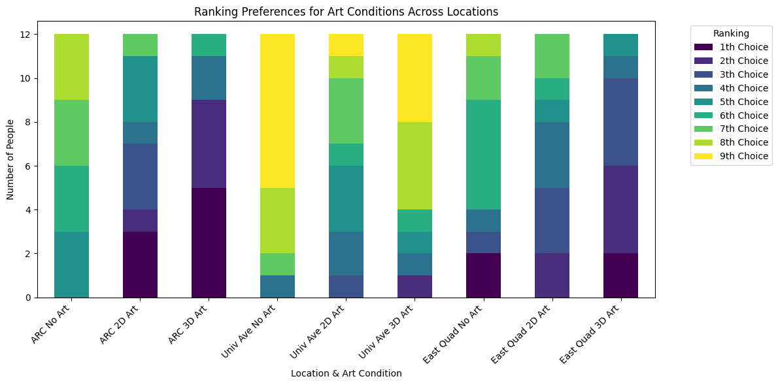
Condition Ranking
Notes:
We also got the participants all the conditions. This shows a similar trend as the individual but allows us to view specific conditions. For example, we can see that the 2D art condition on University Avenue isn't seen nearly as badly as the other two. We also see generally more positive opinions on the ARC condition than in the location ranking. This could indicate that while people might like the actual look of the Quad better, they thought that the ARC better suited the experience.

Slide 14
Qualitative data
(P11 "In the Quad, with the models, it made the space feel less open and more closed in, but in the road, it felt out of place.")
(P12 "It’s not the same as seeing it in real life, but maybe I’m just oldschool.")
(P8 “It changes what you see when you stop looking at the art.")
(P1 "I liked being able to move around the art freely, unlike in a gallery.")
Notes:
Next, we did a thematic analysis on the interview data. These are some of the most interesting quotes. Firstly, Participant 11 talks about how the experience made the space feel smaller to its detriment. Participant 12 talked about how seeing the art digitally didn't feel quite the same as seeing it in person. Participant 8 talked about how the experience causes you to see new things in the space even after the experience ends. Finally, participant 1 talks about much they enjoyed being able to move around the art in a way they couldn't do in a museum.

Slide 15
Conclusion
Generally, people liked the experience and thought it would be something they would consider using in their everyday lives.
There is a statistical significance between the no art and the art conditions, but there isn’t one between the different art conditions and locations.
People mostly had concerns with the art occluding or cutting off important information
Notes:
In conclusion, our data shows that people generally enjoyed the experience, and many of them said they would be interested in using something like this again. We have also shown that there is a statistical significance between the no art and art conditions, indicating that made the experience markedly better. However, we didn't find a statistically significant difference between the different locations or the 2D and 3D art. However, while people generally enjoyed the experience, there were still concerns. One of the main ones being that the art made the space feel smaller and potentially blocked important information, like incoming pedestrians or cars.

Slide 16
Thank you for watching
Notes:
This has been my presentation for my level 4 individual project, thank you for watching!

